Slide 1

WOMEN ENTREPRENEURSHIP INDEX
Isha Goel, Regina Guzanova, Vaneesh Kapoor
Notes:
Isha

Slide 2
ABOUT THE DATASET
01
OUR MODELS
02
TABLE OF CONTENTS
COMPARING RESULTS
03
POTENTIAL IMPROVEMENTS
04
A summary of our features and preprocessing steps
The 5 different models and their regression metrics
Using hyperparameters to determine best configurations
How to achieve even better results in the future
Notes:
Vaneesh

Slide 3

OUR PROBLEM
We are looking to study how different factors affect the Women Entrepreneurship Index. Based on that, we are trying to predict the Women Entrepreneurship Index around the World. Our goal is to determine what factors influence the Women Entrepreneurship Index and how it can potentially be increased overall and in countries with lower Women Entrepreneurship Index.
Notes:
Regina

Slide 4


ABOUT THE DATASET
01
Notes:
Isha

Slide 5
OECD COUNTRIES
The research is limited to OECD countries where all data for 2015 is available simultaneously
Notes:
Isha
The Organisation for Economic Co-operation and Development (OECD) is an international organisation that works to build better policies for better lives.

Slide 6
FEATURES SUMMARY
No. (or Country ID, which we will remove)
Country - Country Name
Level of development - Nominal variable for Developing Index
European Union Membership - Nominal variable for EU Membership
Currency - Currency
Entrepreneurship Index - Entrepreneurship Index 2015
Inflation rate - Inflation Rate 2015
Female Labor Force Participation Rate - Female Labor Force Participation Rate 2015
*Gender Inequality Index - 2019 rankings
*Ease of Doing Business - A high ease of doing business ranking means the regulatory environment is more conducive to the starting and operation of a local firm.
*Corporate Tax Rates % by country 2020
*Schooling - Years
Notes:
Isha

Slide 7
3 features
ONE-HOT ENCODER
2 features
DROPPED
PREPROCESSING DATA
5 features
NORMALIZER (NORM='l1')
1 features
MIN MAX SCALER
Notes:
Isha

Slide 8
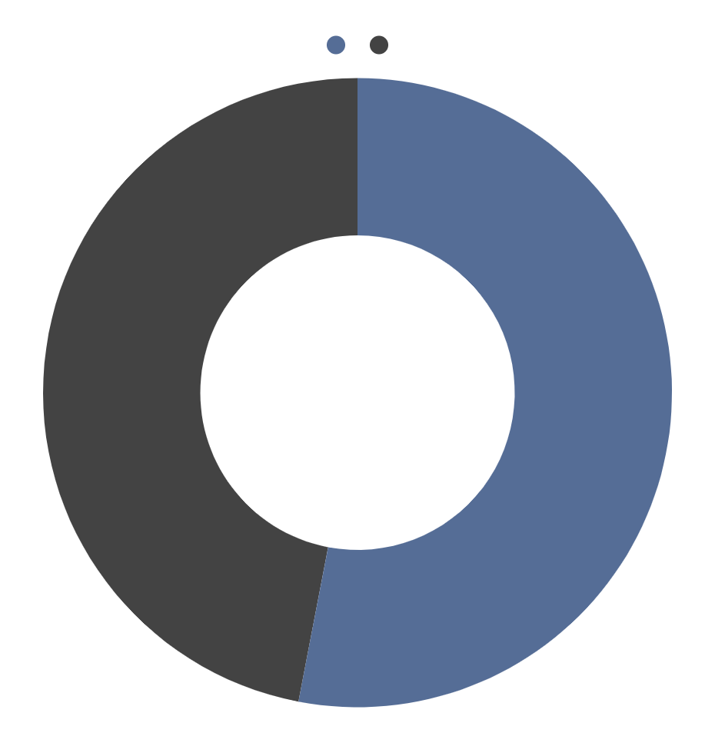
DEVELOPED
53%
DEVELOPING
47%
LEVEL OF DEVELOPMENT
With an approximately even split of the level of development for the countries being represented, we know that the data chosen for training is representative of the entire population
Notes:
Isha

Slide 9
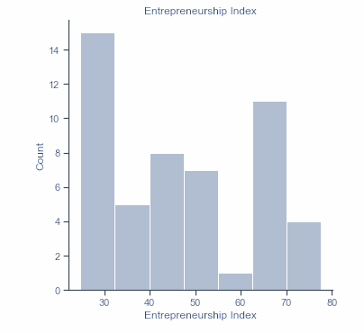
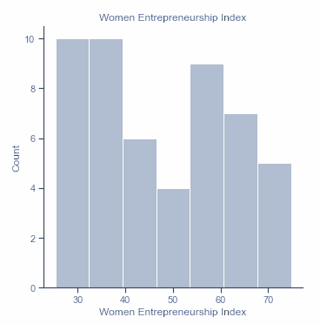
ENTREPRENEURSHIP INDEX
COMPARING INDEXES
WOMEN ENTREPRENEURSHIP INDEX
14
12
10
8
6
4
2
0
A larger range with a higher max count but less populated
30 40 50 60 70 80
10
8
6
4
2
0
A smaller range and less counts but more densely populated
30 40 50 60 70
Notes:
Isha

Slide 10
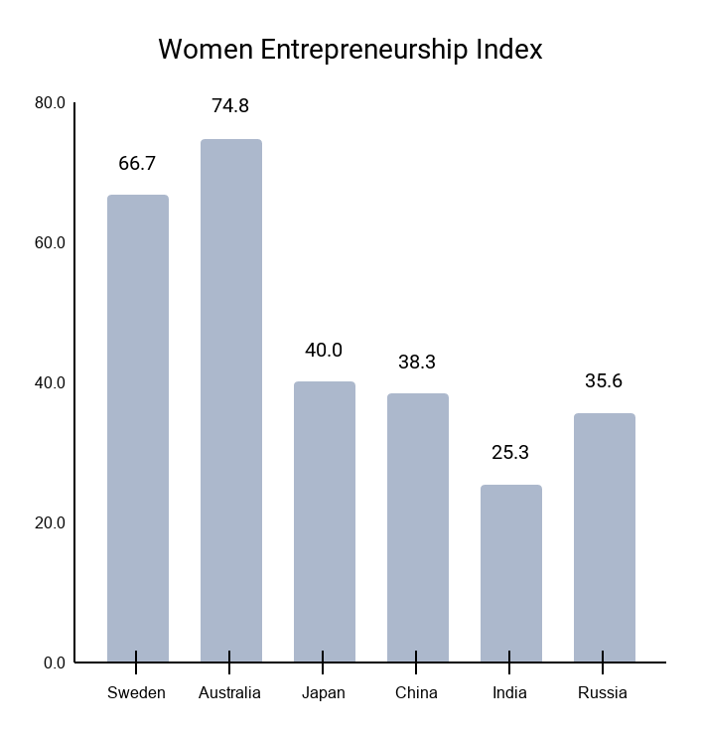

CONSIDERING REGIONS
Average Value:
46.8
African and South American regions tend to have lower values in the 20-30 range, and Eurasian countries range in the 30-60 index value. While Nordic regions are higher in the 70-80 range.
Notes:
Regina

Slide 11
OUR MODELS
02
Notes:
Vaneesh

Slide 12

SGD
REGRESSOR
LINEAR
LASSO
VOTING
REGRESSOR
LASSO
RESULTS OF THE 5 MODELS
LINEAR
REGRESSION
LINEAR REGRESSION
DECISION TREE
REGRESSOR
LIMITATIONS
MSE: 45.41993673699133
R2 Score: 0.7892016125287313
Max Error: 20.954947053849622
MSE: 41.45101557704919
R2 score: 0.8076217654532292
Max error: 18.776541412939736
MSE: 35.87367563288831
R2 Score: 0.8335067479316546
Max Error: 17.955427310543286
MSE: 41.45101557704919
R2 score: 0.8076217654532292
Max error: 18.776541412939736
MSE: 35.30270512091824
R2 score: 0.8361566781575351
Max error: 18.25202381014924
MSE: 35.30270512091824
R2 score: 0.8361566781575351
Max error: 18.25202381014924
MSE: 0.0
R2 Score: 1.0
Max Error: 0.0
Multicollinearity of features
Hyperparameter ranges
Improper data transformation
Notes:
Vaneesh

Slide 13
COMPARING MODELS
03
Notes:
Isha

Slide 14
HYPERPARAMETERS
ALPHA | 0.003 | 0.5 | 1 | 5
SGD | 0.78 | 0.57 | 0.46 | 0.18
LASSO | 0.82 | 0.74 | 0.70 | 0.25
DEPTH | 5 | 6 | 7 | 8
TREES | 0.98 | 0.99 | 0.99 | 1.00
*We tested different n_jobs values for Linear Regression and it had no effect on the results.
*Our Voting Regressor utilized the Lasso model in combination with Linear Regression model, which we already optimized above.
Notes:
Isha

Slide 15
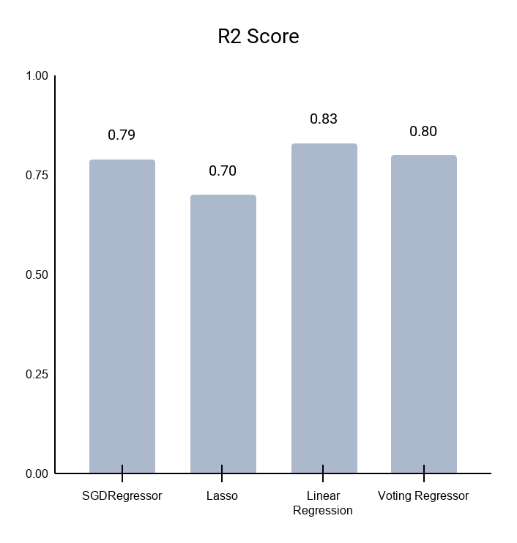
R2 SCORE
A statistical measure that represents the proportion of the variance for a dependent variable that's explained by an independent variable or variables in a regression model.
Notes:
Isha

Slide 16
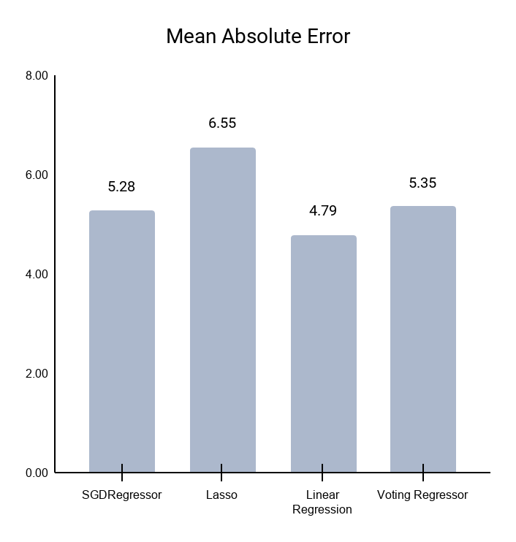
MAE
The mean of the absolute values of the individual prediction errors on over all
instances in the test set.
Notes:
Isha

Slide 17
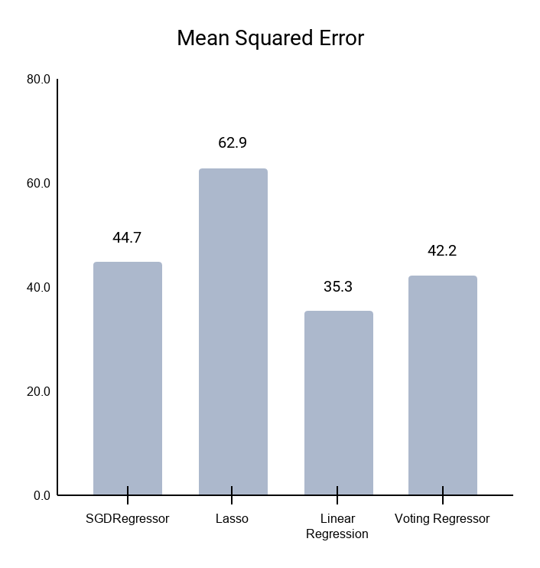
MSE
Measures the average squared difference between the estimated values and the
actual value.
Notes:
Isha

Slide 18
METRICS
TEST RESULTS
FEATURES
Linear Regression
y_test
y_pred
MSE: 6.33946266954
R2 score: 0.908568739066
Max error: 5.05463671384
31.1
30.8
36.9
35.2
31.6
28.7
The top 3 features influencing Women Entrepreneurship Index:
Ease of Doing Business
Entrepreneurship Index
Schooling (years)
55.9
55.6
37.0
42.1
41.2
42.3
Notes:
Isha
We believed that linear regression performed exceptionally well due to the fact that there was minimal noise in the dataset itself and its less complex nature went well with the simplicity of the linear regression model.
Voting Regressor would be our second model choice. It has similar results to the Linear Regression since we included Linear Regression and Lasso into our Voting Regressor model.

Slide 19
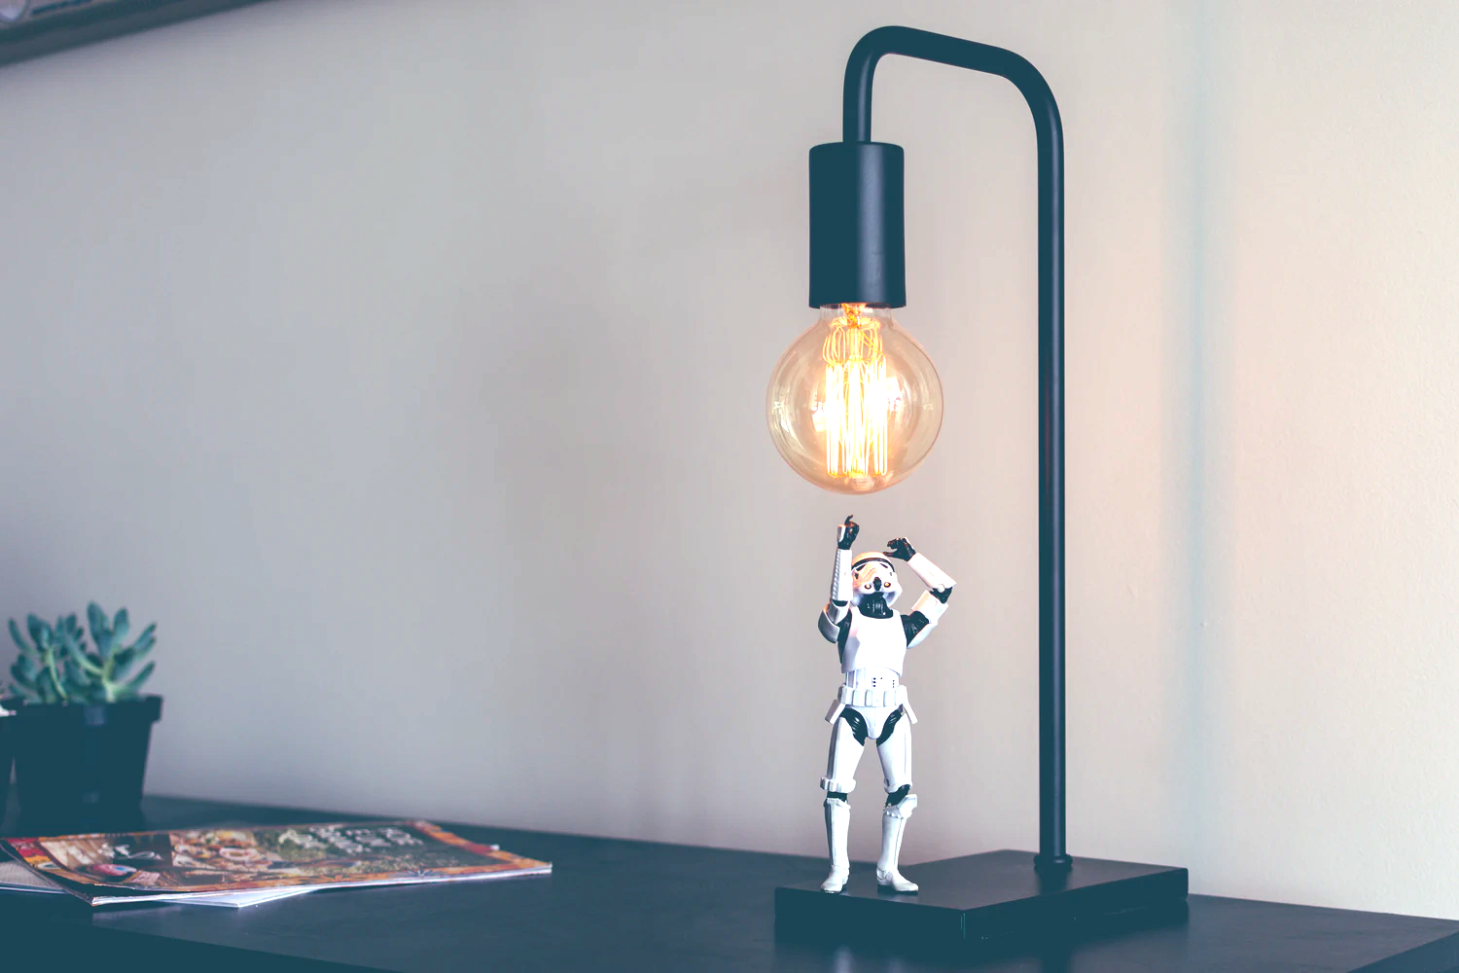
POTENTIAL IMPROVEMENTS
04
Notes:
Regina

Slide 20




MORE DATA
NEW REGIONS
FURTHER IMPROVEMENTS
ADDED FEATURES
NONLINEAR MODELS
Include more countries outside of the OECD for better Representation
Employ the model on a different regions to see if it can be further generalized
If found, include data for how culture influences entrepreneurship rates as well as available startup financing options from the government or other institutions
The new dataset with added features could potentially be better fit with a natural log or polynomial function
Notes:
Regina

Slide 21
THANK
YOU

